Slide 1
Adding Flexibility and Scalability to Bouygues Telecom with MongoDB
Pierre-Alban DEWITTE
@__pad__
Bouygues Telecom
MongoDB World – 06/24/2014

Slide 2




Bouygues Telecom
13 M Customers
Notes:
Part of Bouygues group, mostly know in us for COLAS firm building and maintaining construction infrastructure
Fourth largest French operator
13 Million customers (Mobile, Landline, Companies …)
Leader in 4G deployment

Slide 3

Who is speaking ?
@__pad__
Notes:
Don’t blame me i’am a Java developer. In charge of a team developing and maintaining systems for Bouygues Telecom

Slide 4
Thanks !
Notes:
Thanks to MongoDB and Norberto Leite who give me the opportunity of share my work
Thanks to Thanks to my boss Erwan who encourage me every week in trying new things
Thanks to Bruno Bonnin, software architect. He makes this project possible by this passion in discovering, helping team every day

Slide 5
Agenda
Adding Flexibility and Scalability to Bouygues Telecom with MongoDB
Existing problems
Design choices
Build
A few steps back
Notes:
Story of the 6 months project. Goal was to replace a legacy app with a new solution based on MongoDB and Storm.
After exposing you what ware our problems and
through 3 important moments design and build share
As a developer, we have a key role in a successful migration to mongodb.
What are your role in success of a migration to MongoDB.

Slide 6
Agenda
Existing problems

Slide 7






Existing problems
Network Connexion system
Consumer
Customers
ETL
LDAP
access
Micropayment system
Existing Sytem
Compagny
Customers
Identity and Oauth management system
Notes:
Save a fresh view of all three kinds of customers coming from different part of our information system.

Slide 8


Existing problems
Two years delay
Schema customization very hard to design and implement
Performance issues
Notes:
Build with a customized out of the box solution.
STOP
Existing problem. Boss call use. Can you expose how mongodb works ? They realize that MongoDb could be a solution.

Slide 9

Existing problems
Notes:
Go POC !

Slide 10

Agenda
Existing problems
Design choices
MongoDB
Tomcat
Storm

Slide 11

Design choices - MongoDB
Schema less data integration
High availability
Sharding
Less expensive data storage allowing duplication
Notes:
You all know MongoDB !

Slide 12


Design choices - Tomcat
POC between Tomcat and NodeJS
We choose our battle, MongoDB !
Notes:
Team like to try new things, why not used node ?
Go quick

Slide 13

Notes:
Scalable database, Scalable front-end but provisioning part will not scale for the customer intergation part if we keep doing our traditional parallelized batch

Slide 14
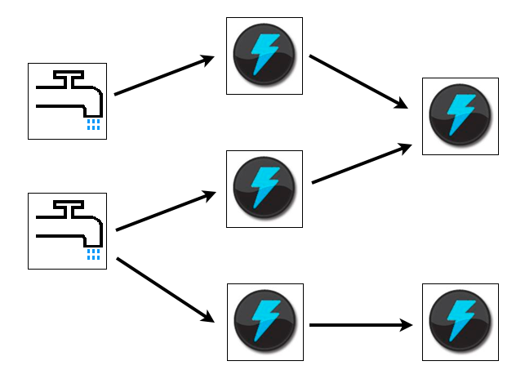
Design choices - Storm
Distributed real-time computation system
Notes:
GO QUICK
Storm well know now for real time processing but you can also use this for a batch
It is scalable, fault-tolerant, guarantees your data will be processed, and is easy to set up and operate.
Suits for real-time data acquisition treatment but also for batch

Slide 15
Design choices - Storm
Network Connexion system
Consumer
Customers
STORM
REST
Micropayment system
MongoDB database
Compagny
Customers
Identity and Oauth management system
Notes:
This is the new design of our system.
POC tests where what we expected. We fell confident enougth to start the building part

Slide 16

Agenda
Existing problems
Design choices
Build
Storm topology
Schema design and refactor
DevOps
Notes:
Focus on three key parts of our project project

Slide 17



Storm topology
1
2
Customer files are pushed every night
Read file line by line
DetectFile
Spout
ProcessLine
Bolt
line
…

Slide 18


Storm topology
4
Oauth
UpdaterBolt
Emitting tuple for each set of functional collections
ProcessLine
Bolt
Identity
UpdaterBolt
3
Transform a line into a document & check delta

Slide 19
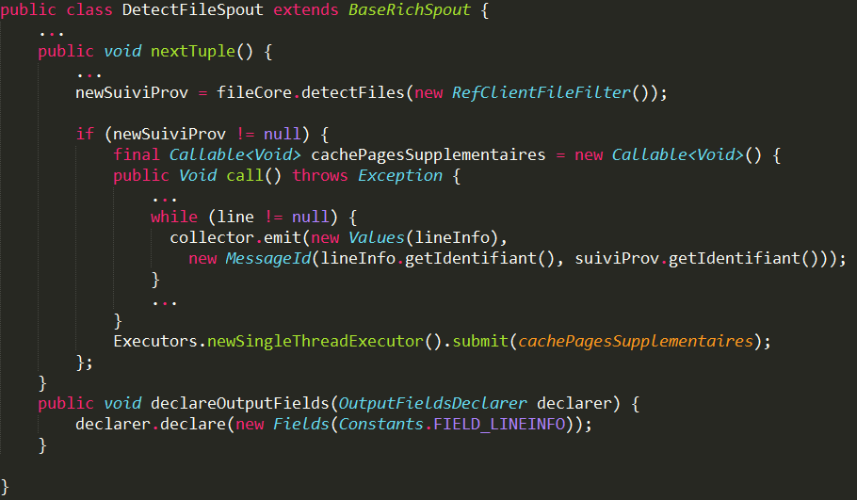
Storm topology

Slide 20
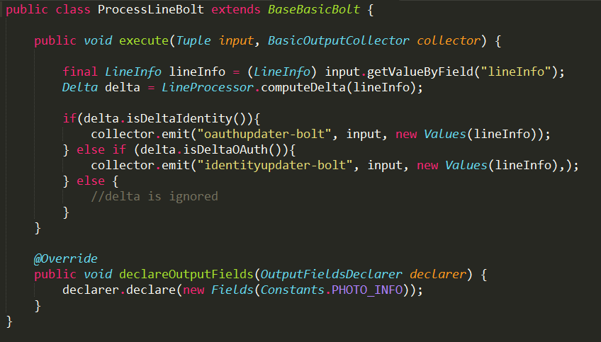
Storm topology

Slide 21
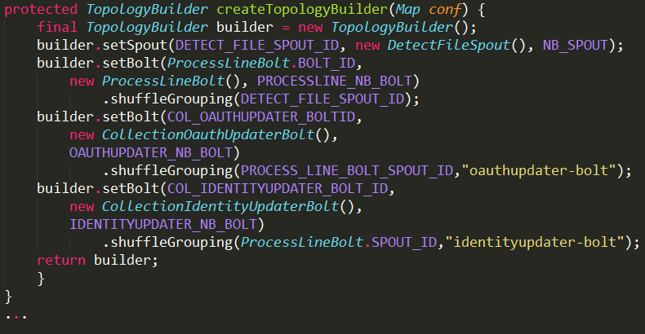
Storm topology

Slide 22
Design choices - Storm
Message failure handle
ack(Object msgId)
failed(Object msgId)

Slide 23
Design choices - Storm
We scaled and easily !

Slide 24
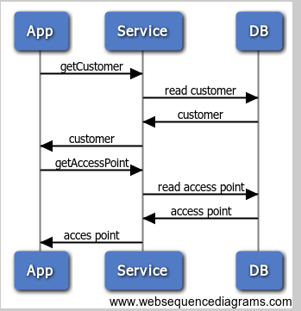
Build - Schema design and refactor
Conception
Conception
User
Name
Compagny
Billcycle
Payment Mode
1
Access Point
Id
Type
Value
1..n
Notes:
Make the design on your use case

Slide 25
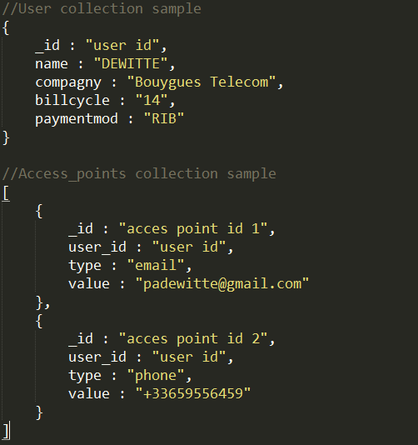
Build - Schema design and refactor
Development
Notes:
Make the design on your use case

Slide 26

Build - Schema design and refactor
Qualification
Notes:
MAJOR ISSUE 1 : « Access points should be returned with user info while reading them »

Slide 27
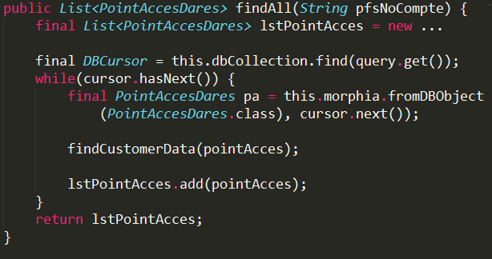
Build - Schema design and refactor
Development
Notes:
Make the design on your use case

Slide 28
Build - Schema design and refactor
Conception
« That works »
Qualification
Notes:
Make the design on your use case

Slide 29

Build - Schema design and refactor
Stress Test
Notes:
Response time where under our expectation during stress test

Slide 30
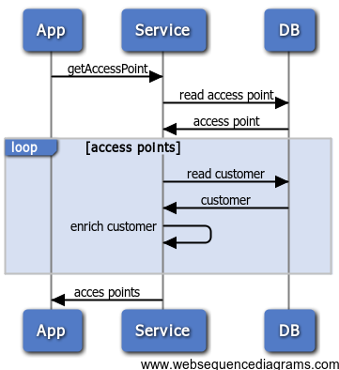
Build - Schema design and refactor
Conception
Conception
Notes:
Retro conception in order to understand where is the bottleneck

Slide 31
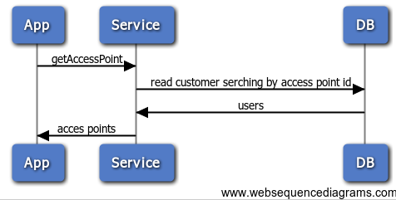
Build - Schema design and refactor
Conception
Conception
Notes:
Re-conception with a merge of user and access point info

Slide 32
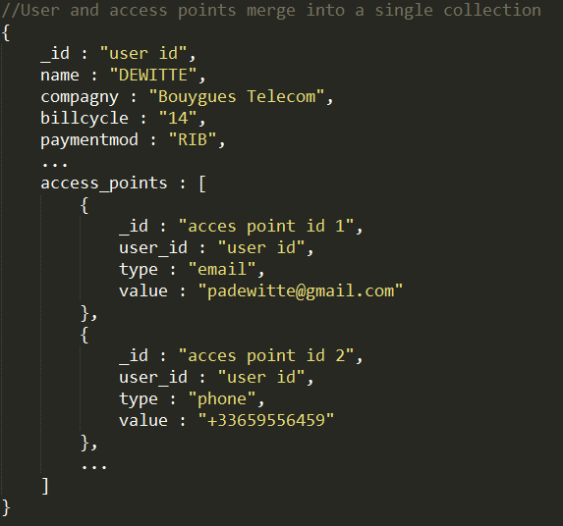
Build - Schema design and refactor
Development
Notes:
Evolution of design
Take care could be a worst approach if access points change frequently. Could implies a database fragmentation.

Slide 33
Build - Schema design and refactor
Conception
Development
Stress Test
Qualification
Notes:
BREAKKKKKKKKKKKKKK

Slide 34
Build - Schema design and refactor
Conception
Development
PERFECT !
Stress Tes
Notes:
We were humble
Code design to
Make the design on your use case
As a team leader i did not plan but i was prepaired to rework
We were prepared to fail
That makes rework painless
BREAKKKKKKKKKKKKKK

Slide 35
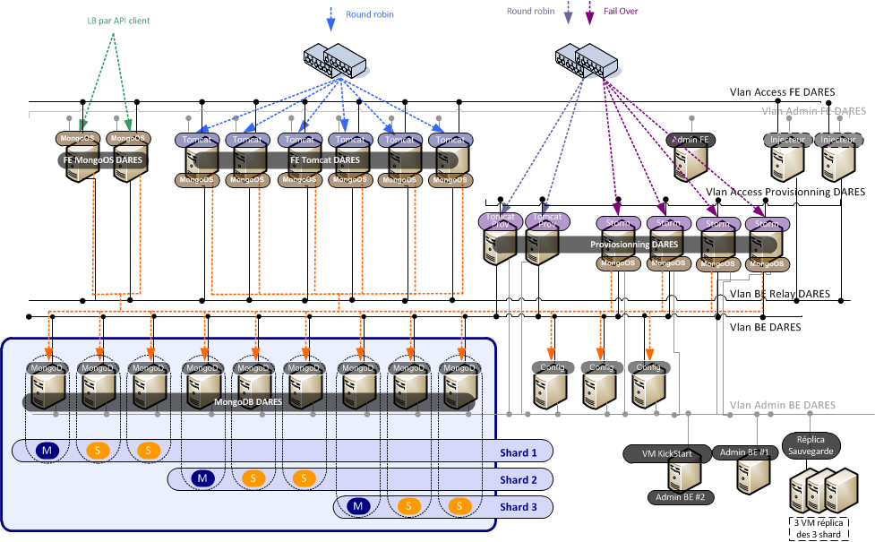
Build - DevOps
Notes:
High availibility comes with a multiplication of servers to managed
Challenge for dev team wich have to deploy application on 34 machines

Slide 36




Build - DevOps
Tooling first
Notes:
Tooling is a developper responsability

Slide 37
Build - DevOps
Moving the line between Dev and Ops

Slide 38
Build - DevOps
Internal training by development team
Redaction of a play-book dedicated to ops
Pre production tests played by both team
Early write of stress tests, played during qualification tests

Slide 39
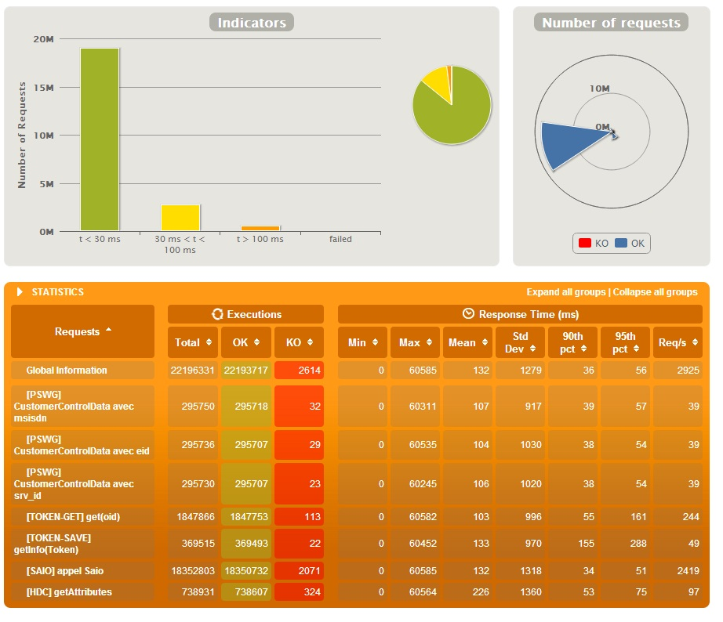
6 months later
Notes:
3000 req/s
95% req < 100ms
500 000 customers
loaded in less than 2 hours

Slide 40

Agenda
Existing problems
Design choices
Iterations during build
A few steps back

Slide 41




A few steps back
Apache Tomcat
Apache STORM
Flexibility and Scale with a 100% Open Source Stack !
Notes:
Scaling with a 100% open source stack it is possible !
We reach MongoDB and it was fine

Slide 42

A few steps back
Choose your battle
Use the right tool for the right job
Be prepare to fail and to rework
To move organization, training is a key
Notes:
We want know do more

Slide 43
Thank you for listening
Questions ?
Further talks @__pad__

Slide 44
Photo credits
100 m start :
http://fr.wikipedia.org/wiki/100_m%C3%A8tres_%28athl%C3%A9tisme%29#mediaviewer/Fichier:Mens_100m_finals_British_Champs_and_Olympic_Trials.jpg by Paul Foot from Birmingham, UK
Question mark block : https://www.flickr.com/photos/jarbo/9379813470 by Jared Cherup
Pelleteuse orange :
http://fr.123rf.com/photo_3669950_un-grand-pelleteuse-orange-stationne-a-un-chantier-de-construction.html by Stephen Mcsweeny
Punaise : https://www.flickr.com/photos/24362608@N05/3501112978/sizes/l/in/photolist-f5R8g4-6kiVfR-6koahu-6ko7US-6ko8Qh-d9NUKU-nDi2eb-ffg13f-8h56wx-cgAcib-hchCtD-decZ4p-6kocrL-6kj2J6-5doxaw-gbTPmK-nCFBBq-672Snf-2sCzvw-e1zAjM-8voRbc-c9Rh1m-amFFGt-2iZNBq-cFSnFU-81Ckk4-2XHZAy-9Ggpfw-m8FfKz-8hW6r5-4xSuxC-awXsp4-5aVn7g-fbXVHZ-9GAPLX-9qr7uU-fcddgA-cP1EN7-np2q92-6V8oBT-cenSsb-cyzaEd-8h5a2F-6V2b3F-ch1RME-fJ52s3-9XthVN-kBs5mW-6qSPaF-5cA9Qb/ par
dractrain94
Une longue vue qui louche : https://www.flickr.com/photos/la_bretagne_a_paris/3847733265/ par Yann Caradec
NASA-Apollo8-Dec24-Earthrise : http://www.hq.nasa.gov/office/pao/History/alsj/a410/AS8-14-2383HR.jpg par NASA / Bill Anders

